Slide 1
Progress on the Industrial Use Cases
DRAFT
Model Writer

Slide 2
DRAFT
AIRBUS industrial use cases
Anne MONCEAUX
AIRBUS GROUP INNOVATIONS

Slide 3
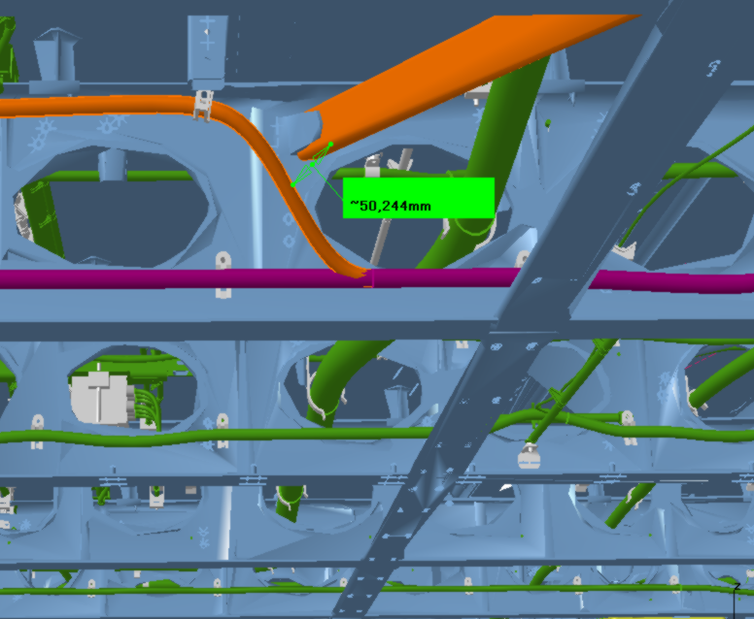
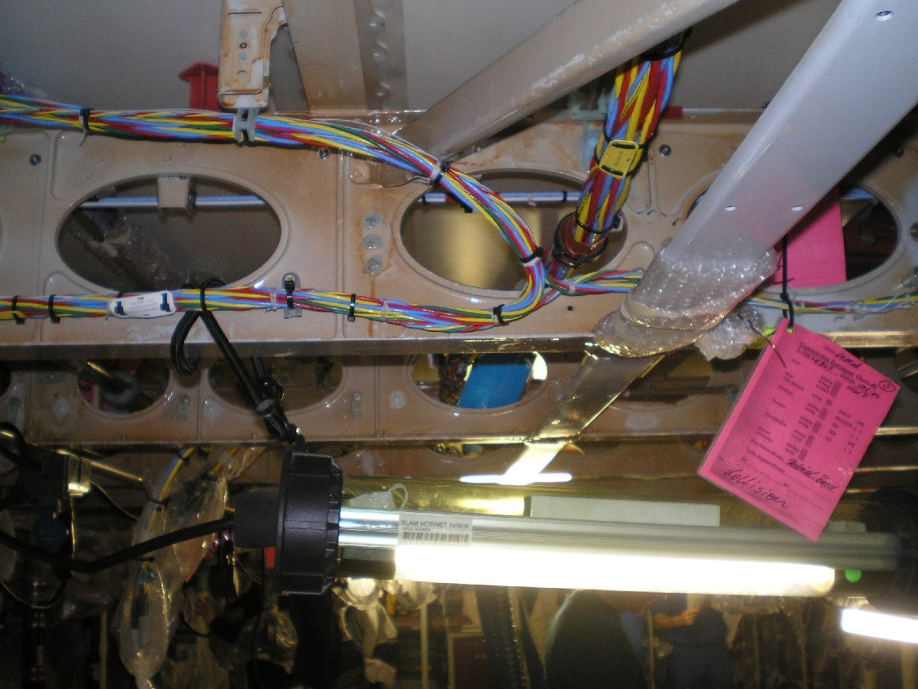
Airbus use cases in ModelWriter
DRAFT
We decided to concentrate on some problematics related to System Installation
We primarily focus on Electrical, Water Waste, and Fuel Systems
System installation:
obeys to some Regulations
is specified by some rules/requirements/principles
the design and the manufactured product are checked against these rules

Slide 4
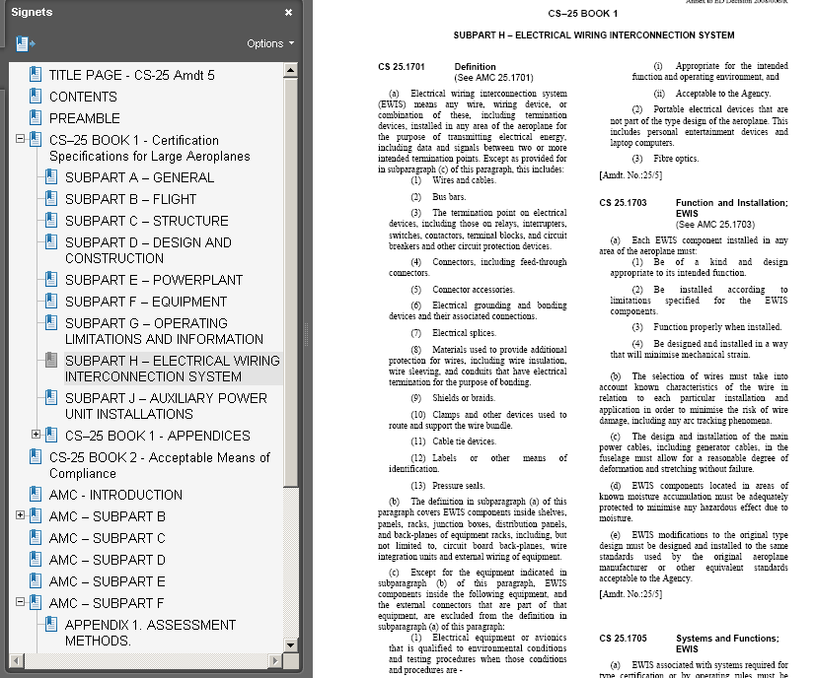
Certification Specification – CS 25 (EASA)
DRAFT
CS 25.1701 Definition
(a) Electrical wiring interconnection system (EWIS) means any wire, wiring device, or combination of these, including termination devices, installed in any area of the aeroplane for the purpose of transmitting electrical energy, including data and signals between two or more intended termination points (...)

Slide 5
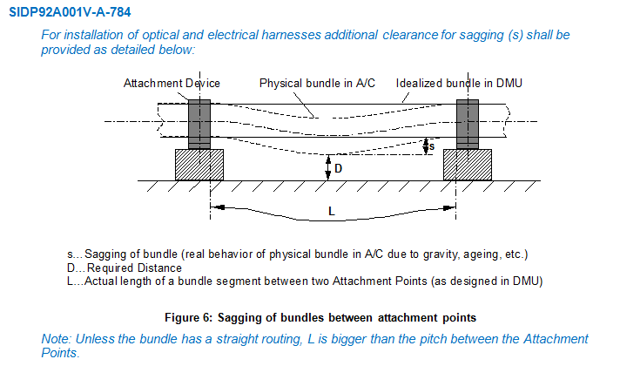
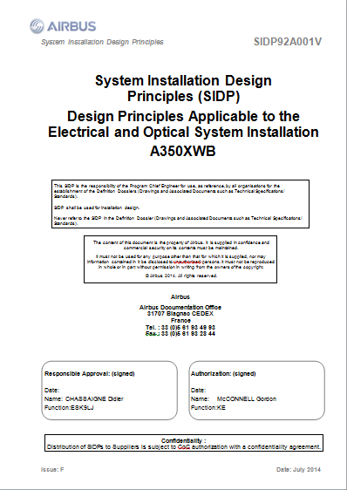
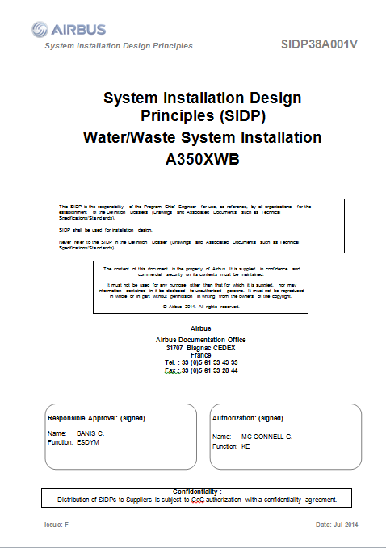
System Installation Design Principles
DRAFT
Notes:
SIDP is used (under Non Disclosure agreement) as a use case

